Slide 1
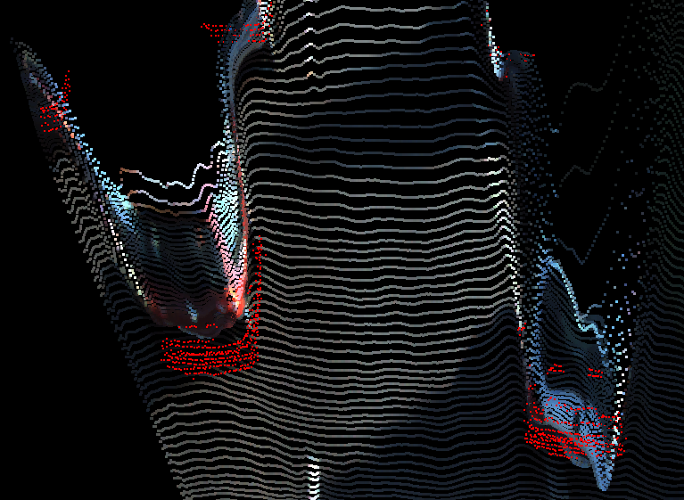
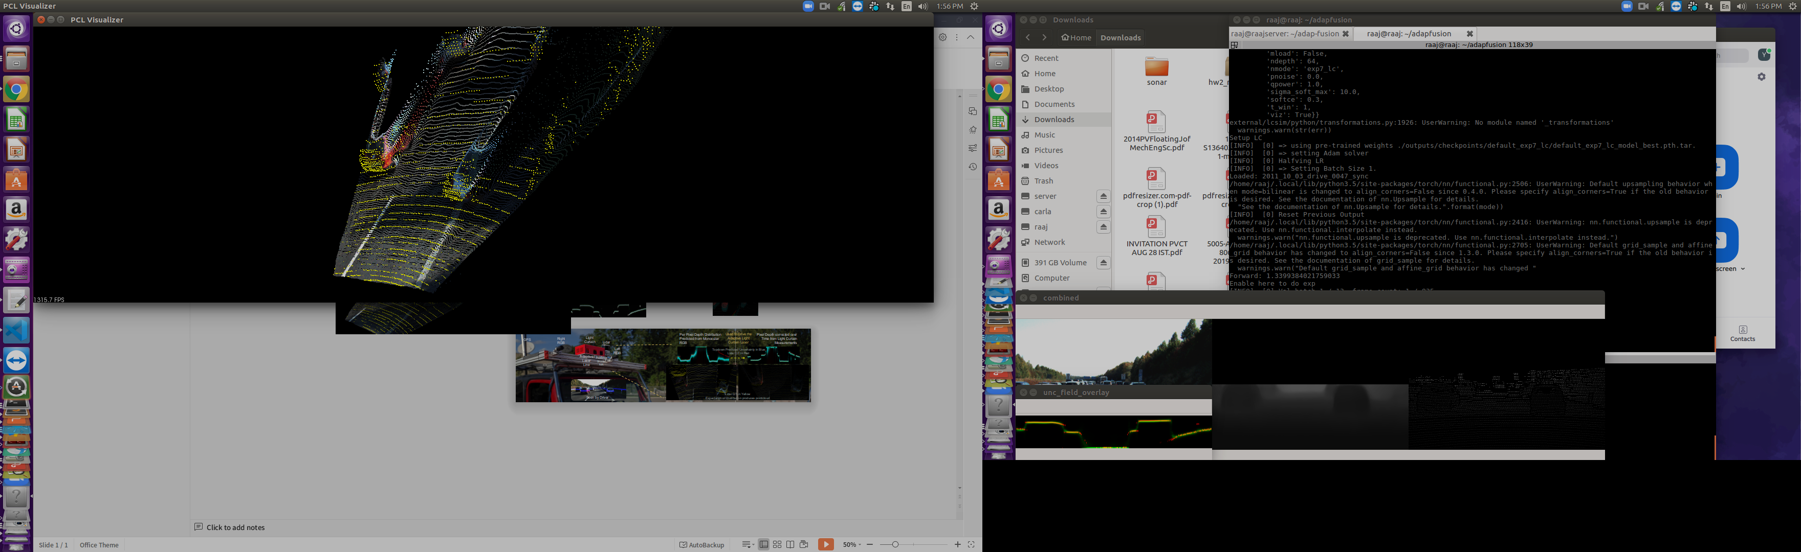
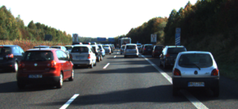
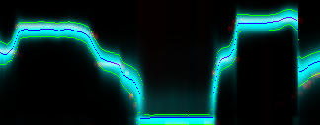
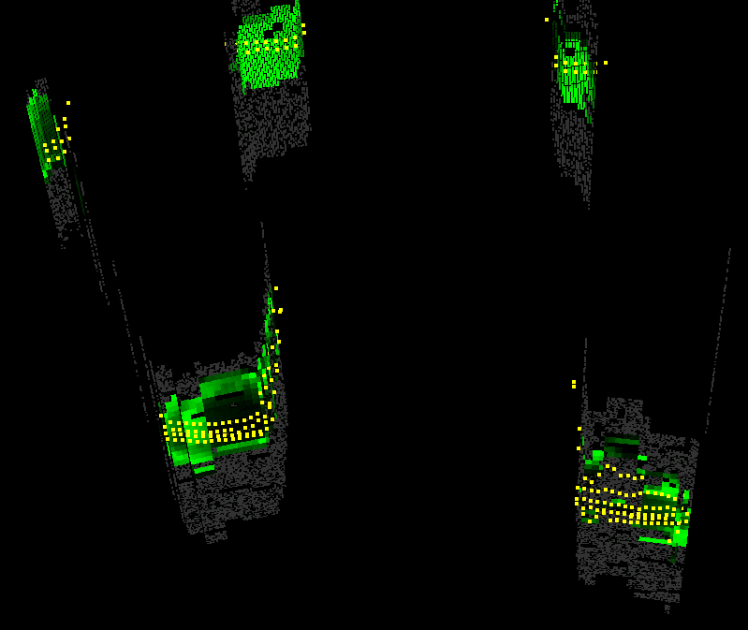
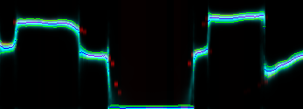
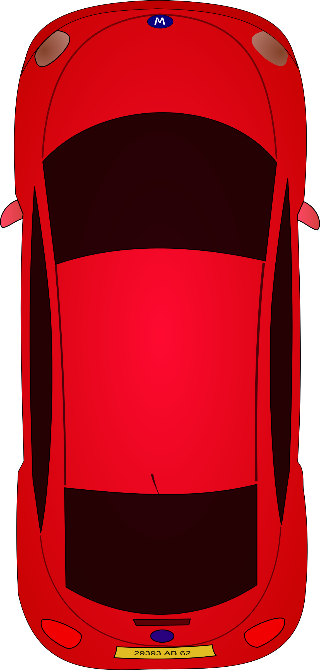
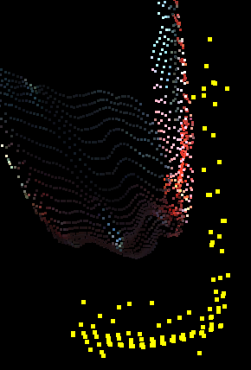
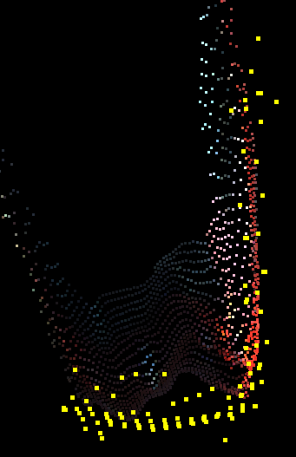
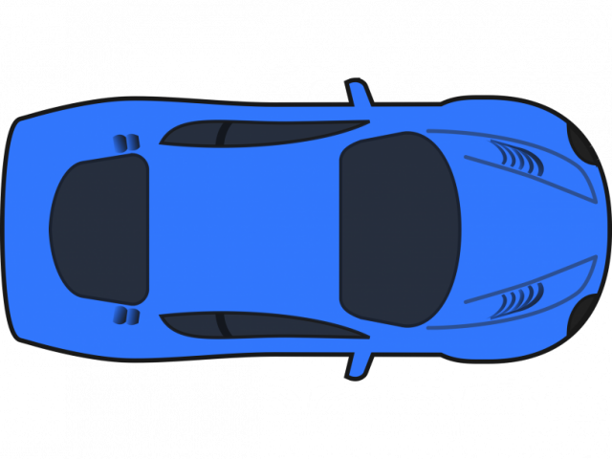
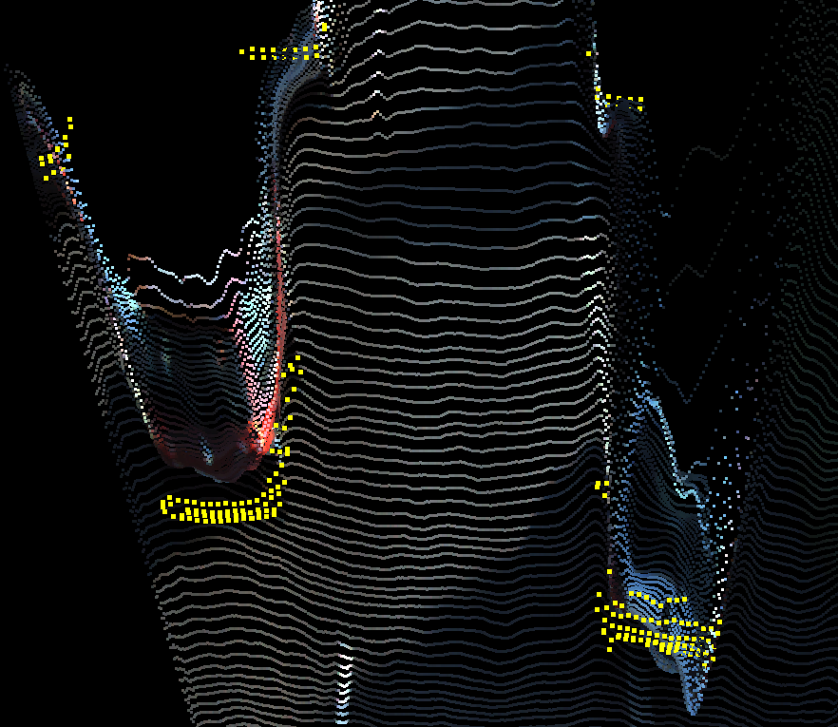
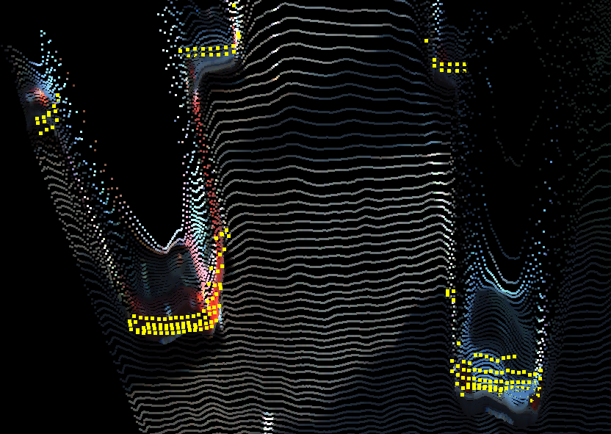
Used to Drive the Adaptive Light Curtain Laser
Lidar GT in Yellow
Expectation of Distribution produces pointcloud
Pixel Depth corrected over Time from Light Curtain Measurements
Topdown Predicted Uncertainty in Blue
Lidar GT in Red
40m
40m
5m
5m
RMSE: 1.2m
RMSE: 0.4m
NIR
Laser
(a) (b) (c) (d)

Slide 2
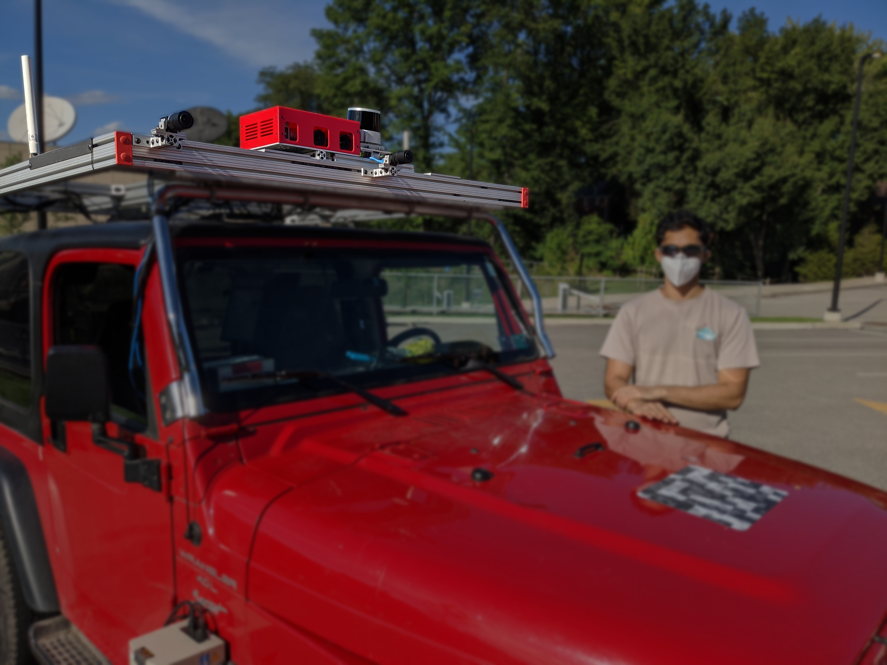
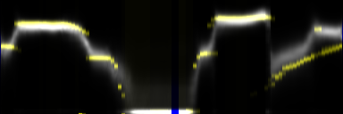
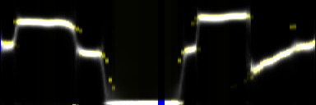
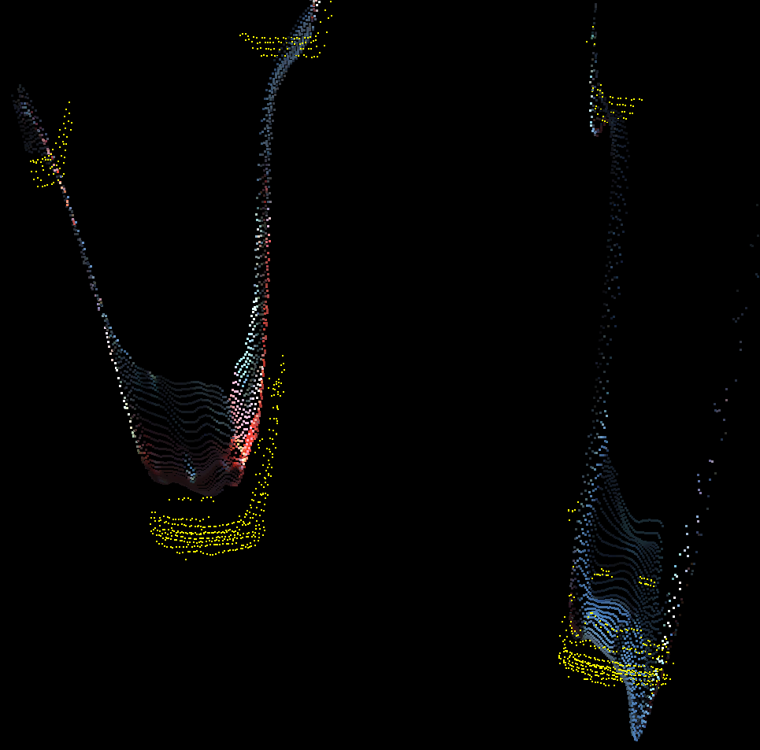
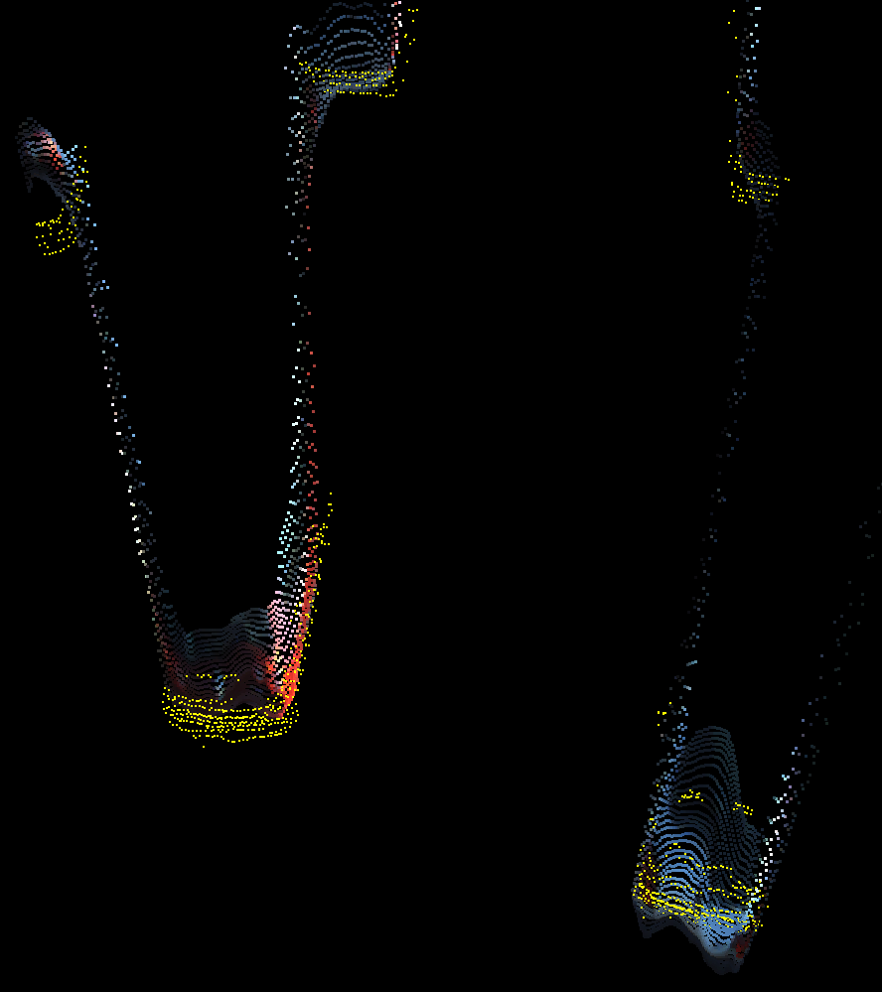
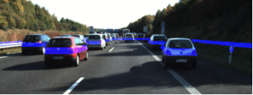
Used to Drive the Adaptive Light Curtain Laser
Lidar GT in Yellow
Expectation of Distribution produces pointcloud
Pixel Depth corrected over Time from Light Curtain Measurements
Topdown Predicted Uncertainty in Blue
Lidar GT in Red
Right
RGB
Light Curtain
GPS
Lidar
Left
RGB
Top Down Depth Uncertaintiy
Adaptive
Laser
Line
Rolling Shutter
NIR
Monocular Uncertainties corrected dynamically by Light Curtain
Left
RGB
Seen by Driver
NIR
Laser

Slide 3
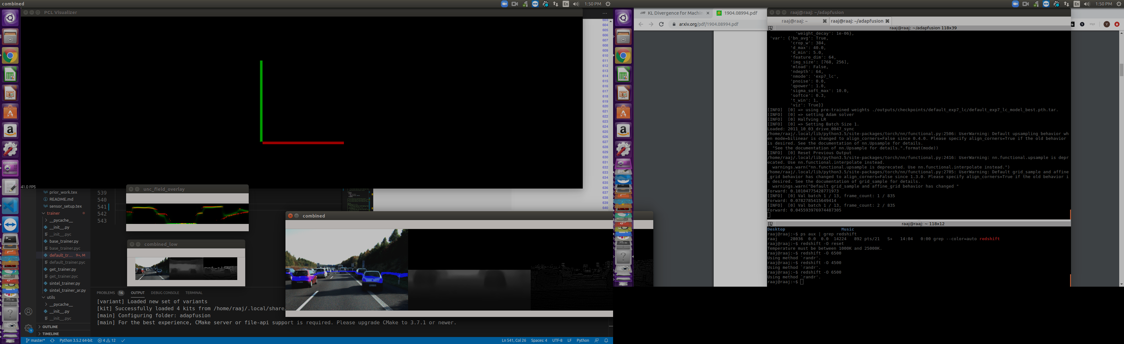
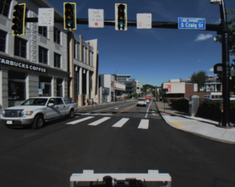
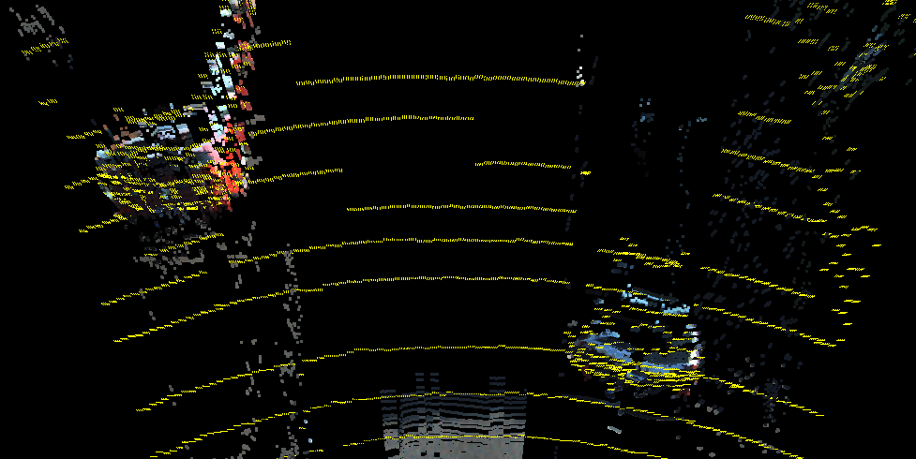
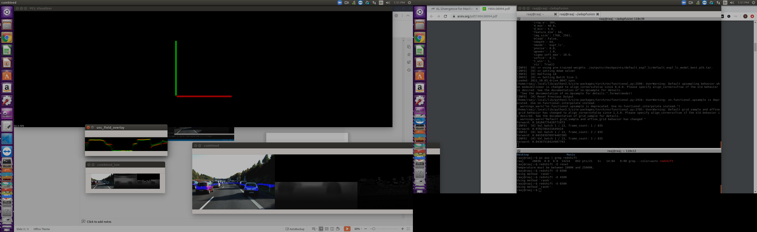

Slide 4
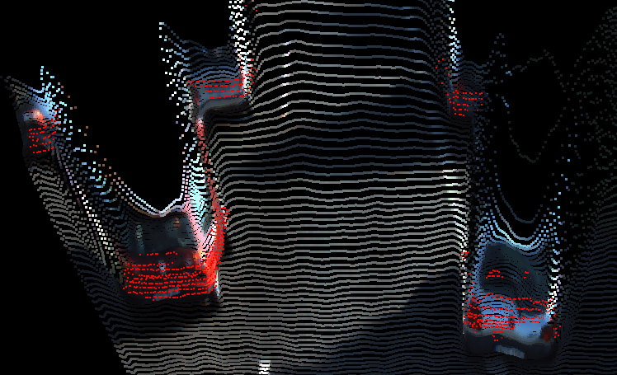
Used to Drive the Adaptive Light Curtain Laser
Lidar GT in Yellow
Expectation of Distribution produces pointcloud
Pixel Depth corrected over Time from Light Curtain Measurements
Topdown Predicted Uncertainty in Blue
Lidar GT in Red
Right
RGB
Light Curtain
GPS
Lidar
Left
RGB
Top Down Depth Uncertaintiy
Adaptive
Laser
Line
Rolling Shutter
NIR
Monocular Uncertainties corrected dynamically by Light Curtain
Left
RGB
Seen by Driver
NIR
Laser

Slide 5
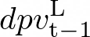
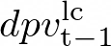
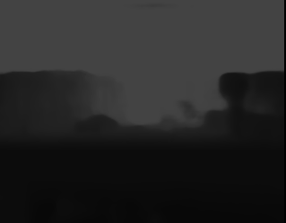
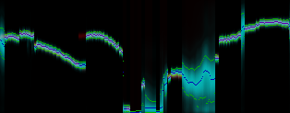
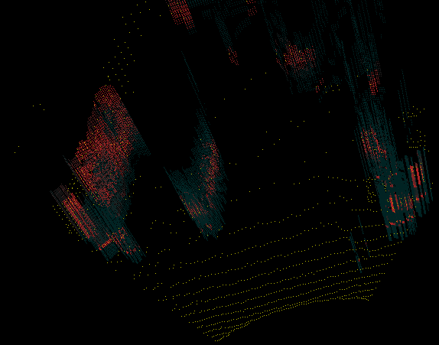
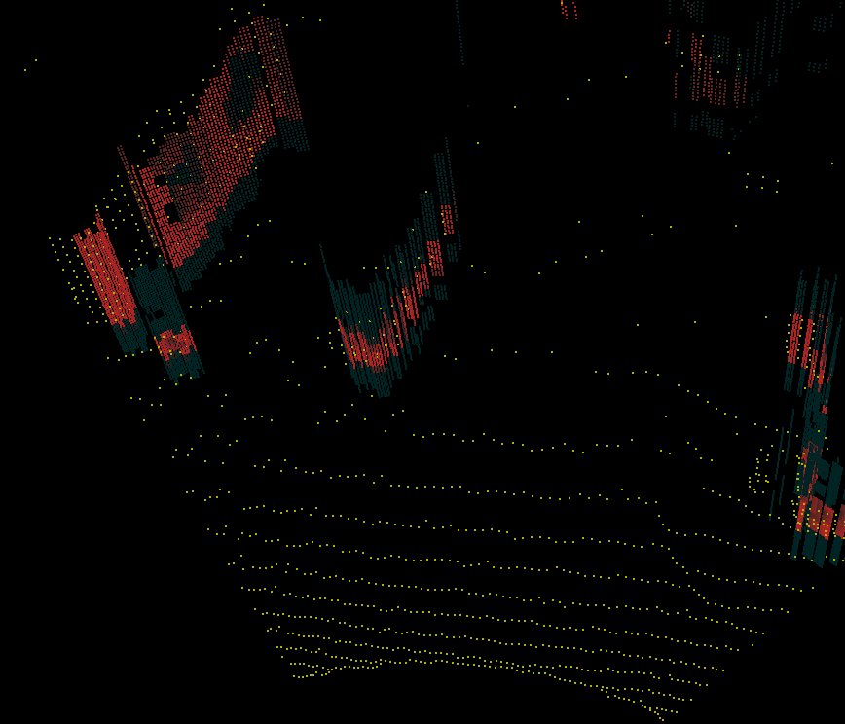
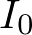
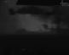
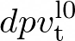
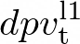
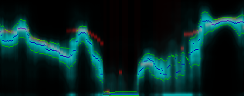
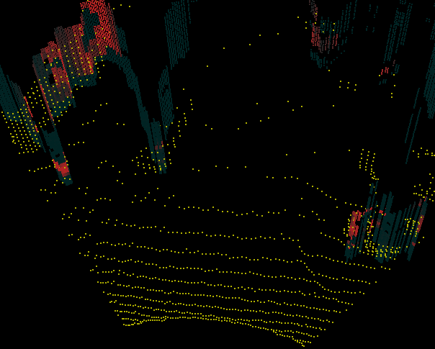
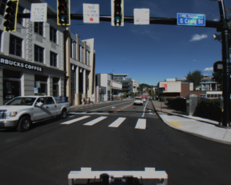
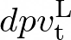
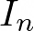
N camera Images
Use DPV to place Light Curtains
High Res DPV
Prev DPV
LC DPV
Shared Encoder
+
Low Res DPV
Low Res DPV
+
+
Warp features based on R,T
Differentiable Homography
DPV Fusion Network
Decoder
...
...
Shared Encoder
+
+

Slide 6
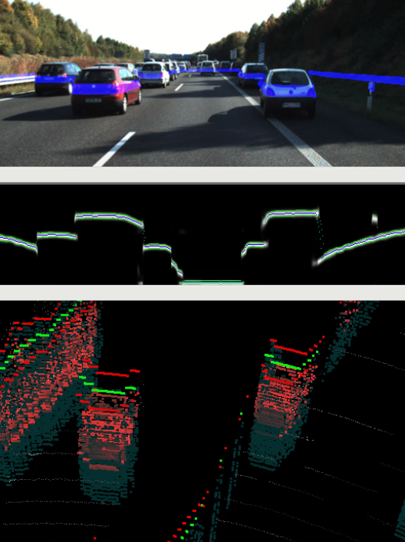
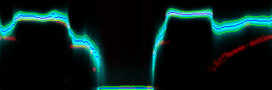
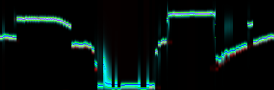
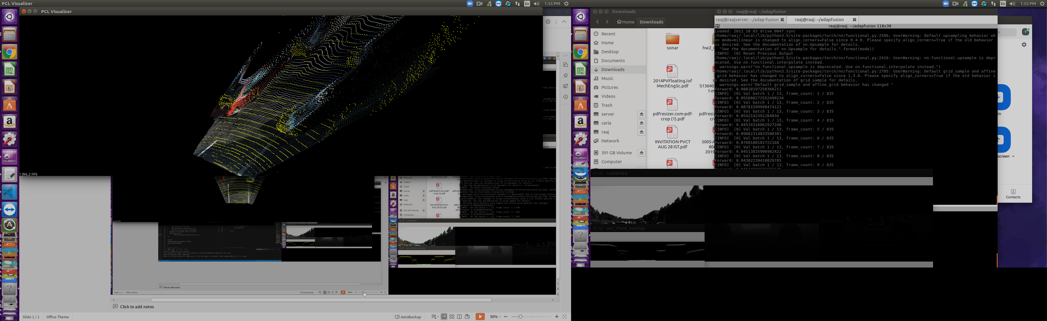
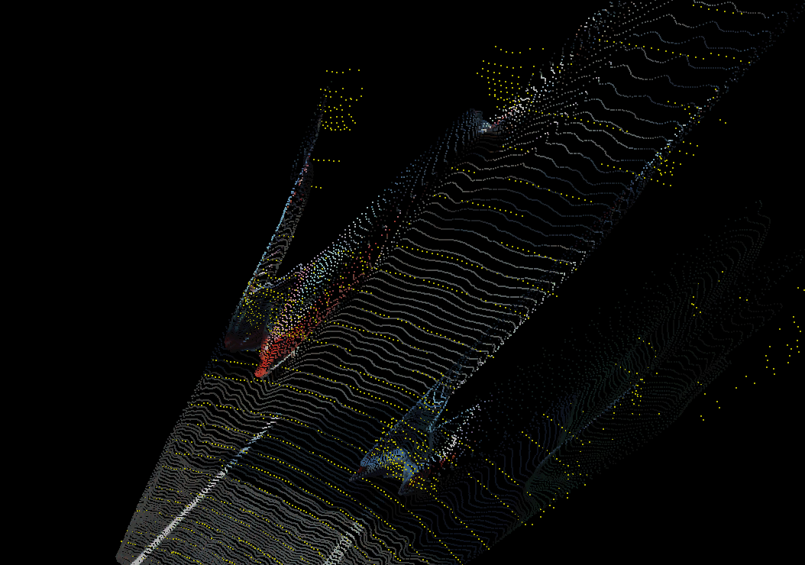
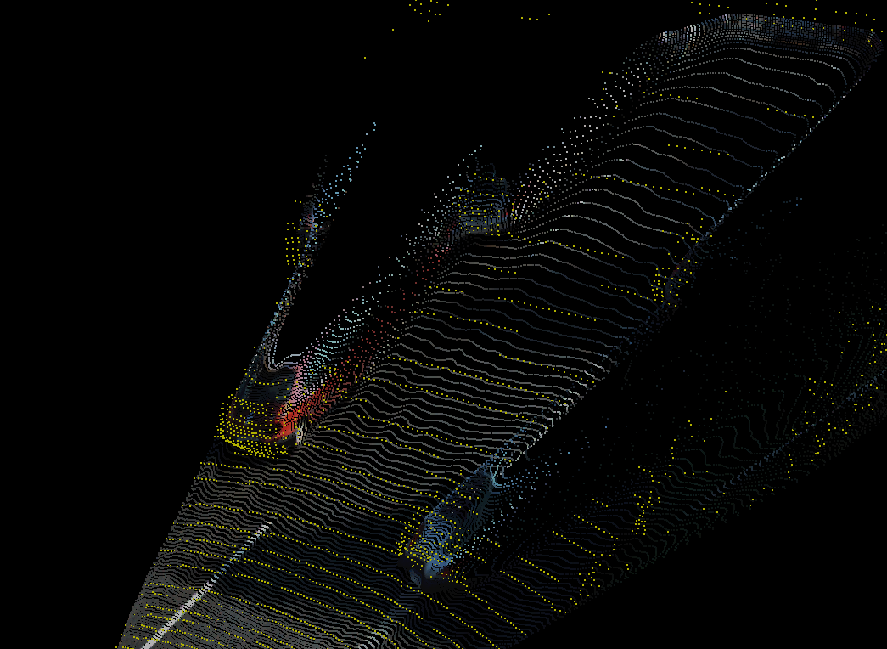
Per Pixel Depth Distribution Predicted from Monocular RGB
Used to Drive the Adaptive Light Curtain Laser
Pixel Depth corrected over Time from Light Curtain Measurements
Topdown Predicted Uncertainty in Blue
Lidar GT in Red
Lidar GT in Yellow
Expectation of Distribution produces pointcloud

Slide 7
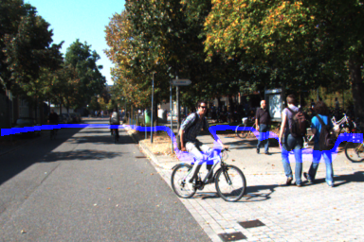
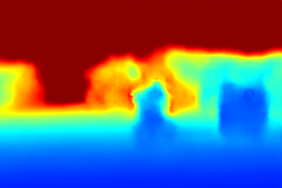
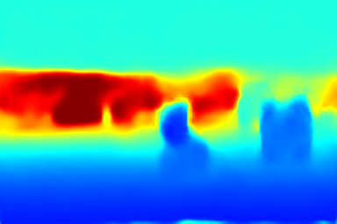
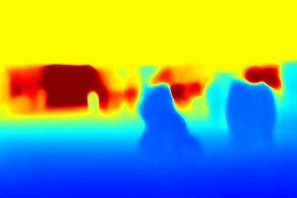
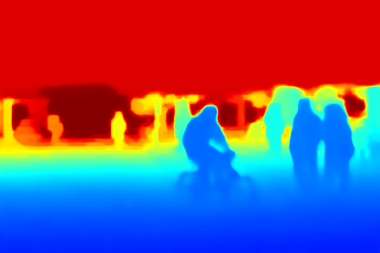
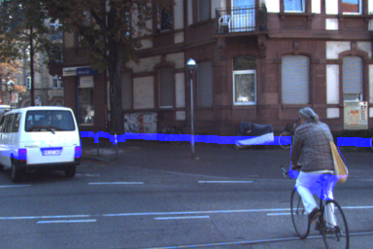




replace with real experiment
RGB
Monocular
Monocular with Light Curtain
Stereo
Lidar Upsampling

